Slide 1
Chapter 4. Convective Dynamics 4.6 Supercell Storms
Photographs © Todd Lindley

Slide 2
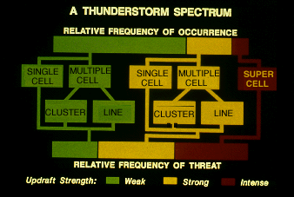

Slide 3
Introduction
A supercell storm is defined as a thunderstorm with a deep rotating updraft.
Supercell thunderstorms are perhaps the most violent of all thunderstorm types, and are capable of producing damaging winds, large hail, and weak-to-violent tornadoes.
They are most common during the spring across the central United States when moderate-to-strong atmospheric wind fields, vertical wind shear and instability are present.
The degree and vertical distribution of moisture, instability, lift, and especially wind shear have a profound influence on convective storm type.
Once thunderstorms form, small/convective-scale interactions also influence storm type and evolution.
There are variations of supercells, including "classic," "miniature," "high precipitation (HP)," and "low precipitation (LP)" storms.
In general, however, the supercell class of storms is defined by a persistent rotating updraft (i.e., meso-cyclone) which promotes storm organization, maintenance, and severity.

Slide 4
Supercell Thunderstorms
A very large storm with one principal updraft
Quasi-steady in physical structure
Continuous updraft
Continuous downdraft
Persistent updraft/downdraft couplet
Rotating Updraft --- Mesocyclone
Lifetime of several hours
Highly three-dimensional in structure

Slide 5
Supercell Thunderstorms
Potentially the most dangerous of all the convective types of storms
Often cause
High winds
Large and damaging hail
Frequent lightning
Large and long-lived tornadoes

Slide 6
Supercell Thunderstorms
Form in an environment of strong winds and high shear
Provides a mechanism for separating the updraft and downdraft
The distinguishing feature of supercells is that the updraft and downdraft remain separated such that they feed on each other.

Slide 7
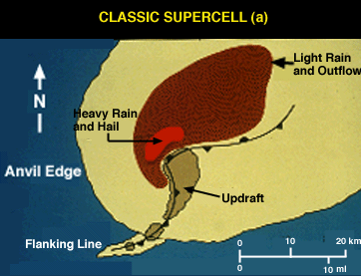
Structure of Classic Supercell Storm – Horizontal cross-section
A horizontal, low-level cross-section of a "classic" supercell.
The storm is characterized by a large precipitation area on radar, and a pendant or hook-shaped echo wrapping cyclonically around the updraft area. Note the position of the updraft and the gust front wave.
The intense updraft suspends precipitation particles above it, with rain and hail eventually blown off of the updraft summit and downwind by the strong winds aloft.
Updraft rotation results in the gust front wave pattern, with warm surface air supplying a continual feed of moisture to the storm.

Slide 8
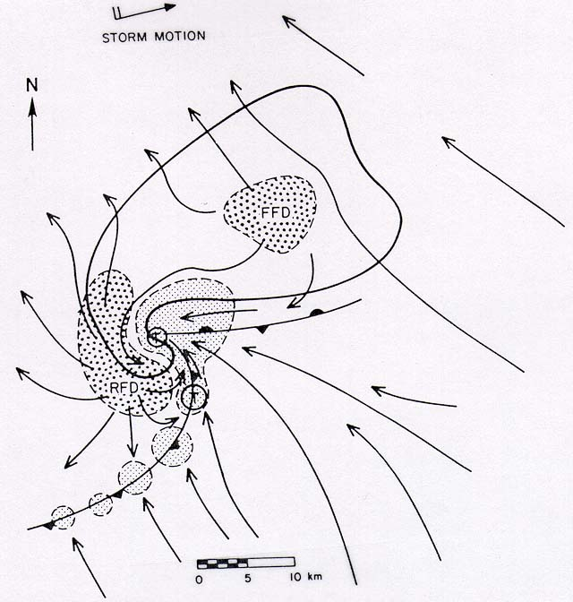
Supercell Structure
Forward Flank
Downdraft
Tornado
Rear Flank
Downdraft
Mesocyclone
Flanking Line/
Gust Front
Inflow
Gustnado
From: Bluestein, Synoptic-Dynamic Meteorology -- Volume II

Slide 9
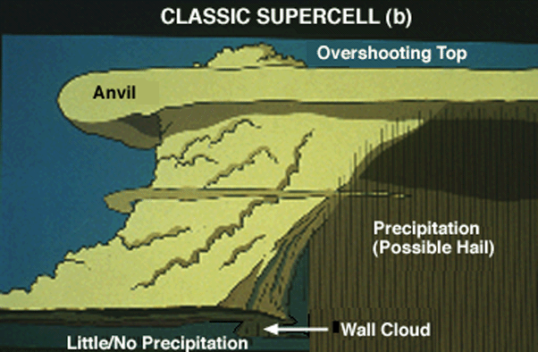
Structure of Classic Supercell Storm - Side view
A westward view of the classic supercell reveals the wall cloud beneath the intense updraft core and an inflow tail cloud on the rainy downdraft side of the wall cloud. Wall clouds tend to develop beneath the north side of the supercell rain-free base, although other configurations occur.
Observe the nearly vertical, "vaulted" appearance of the cloud boundary on the north side of the Cb and adjacent to the visible precipitation area. A sharp boundary between downdraft and rotating updraft results in this appearance.
Note the anvil overhang on the upwind (southwest) side of the storm and the overshooting top, both visual clues as to the intensity of the updraft.
Updraft
Downdraft

Slide 10
A Supercell on NEXRAD Doppler Radar
Hook Echo

Slide 11
Supercell Types
Classic
Low-precipitation
High-precipitation

Slide 12
Classic Supercells
Traditional conceptual model of supercells
Usually some precipitation but not usually torrential
Reflectivities in the hook are usually less than those in the core
Rotation is usually seen both visually and on radar

Slide 13
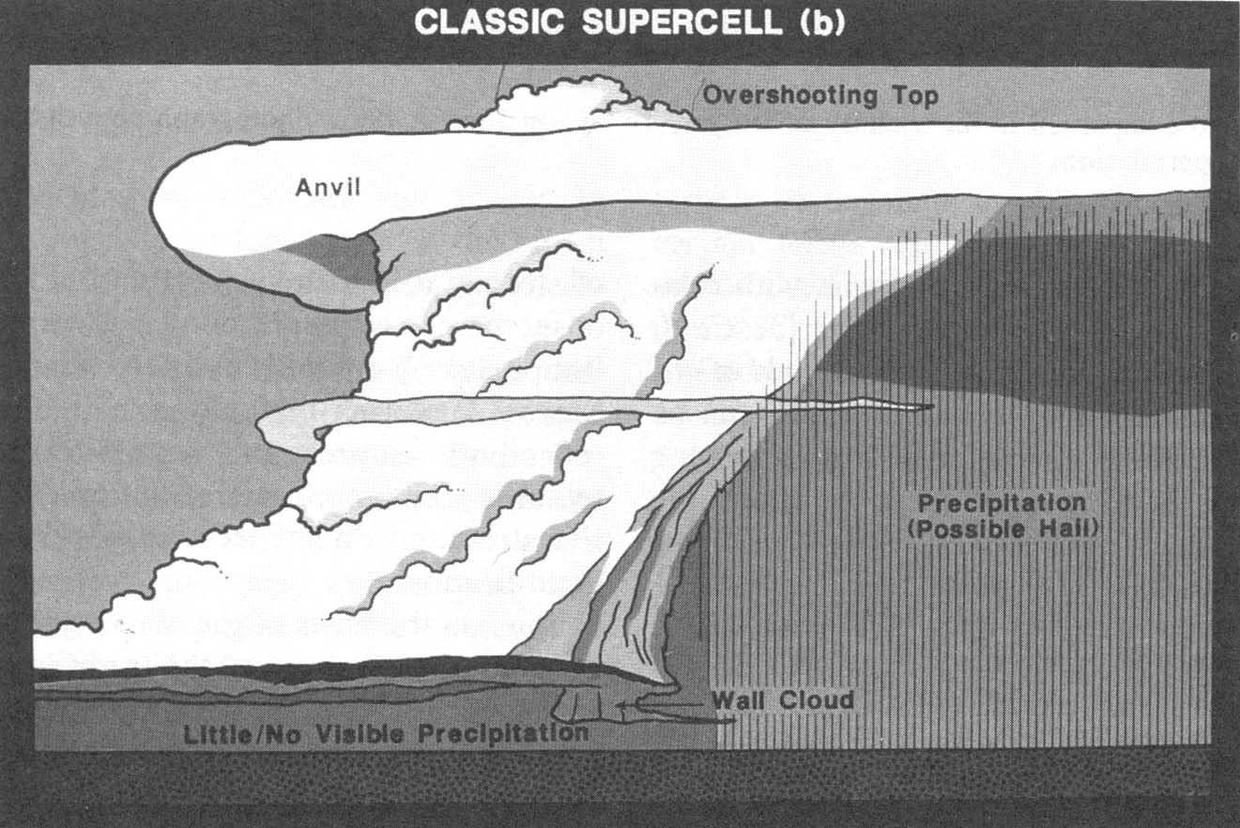
Classic Supercells
© 1993 American Geophysical Union -- From: Church et al., The Tornado

Slide 14
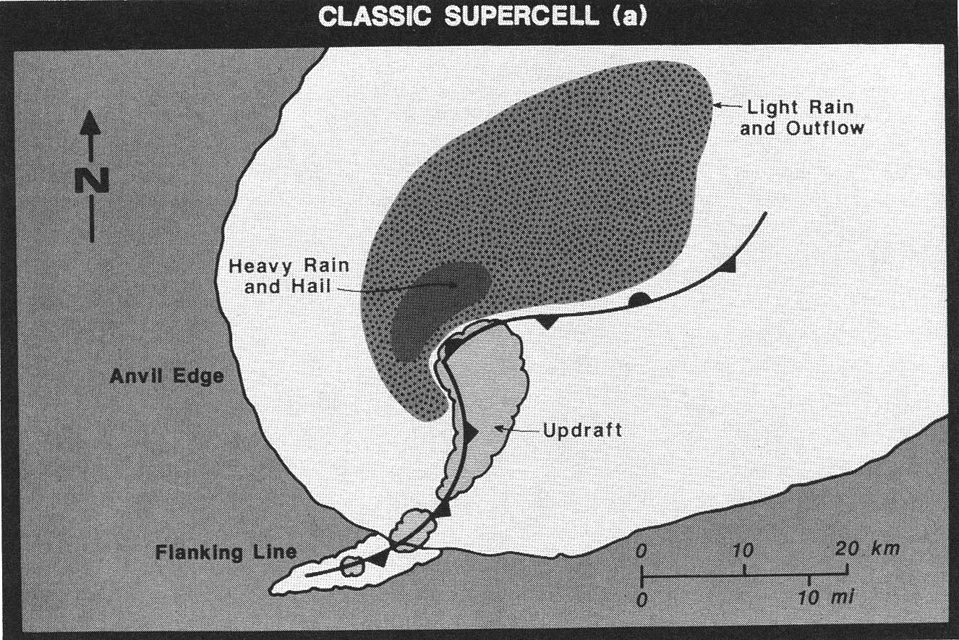
Classic Supercells
© 1993 American Geophysical Union -- From: Church et al., The Tornado

Slide 15
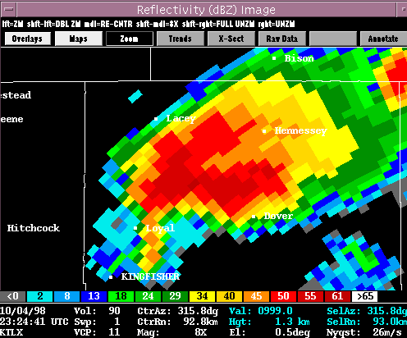
Classic Supercell
Heaviest
Precipitation
(core)
Hook

Slide 16
Low Precipitation (LP) Supercells
Little or no visible precipitation
Clearly show rotation
Cloud base is easily seen and is often small in diameter
Radar may not indicate rotation in the storm although they may have a persistent rotation
LP storms are frequently non-tornadic
LP storms are frequently non-severe

Slide 17
LP Supercell
Side View Schematic
© 1993 American Geophysical Union -- From: Church et al., The Tornado

Slide 18
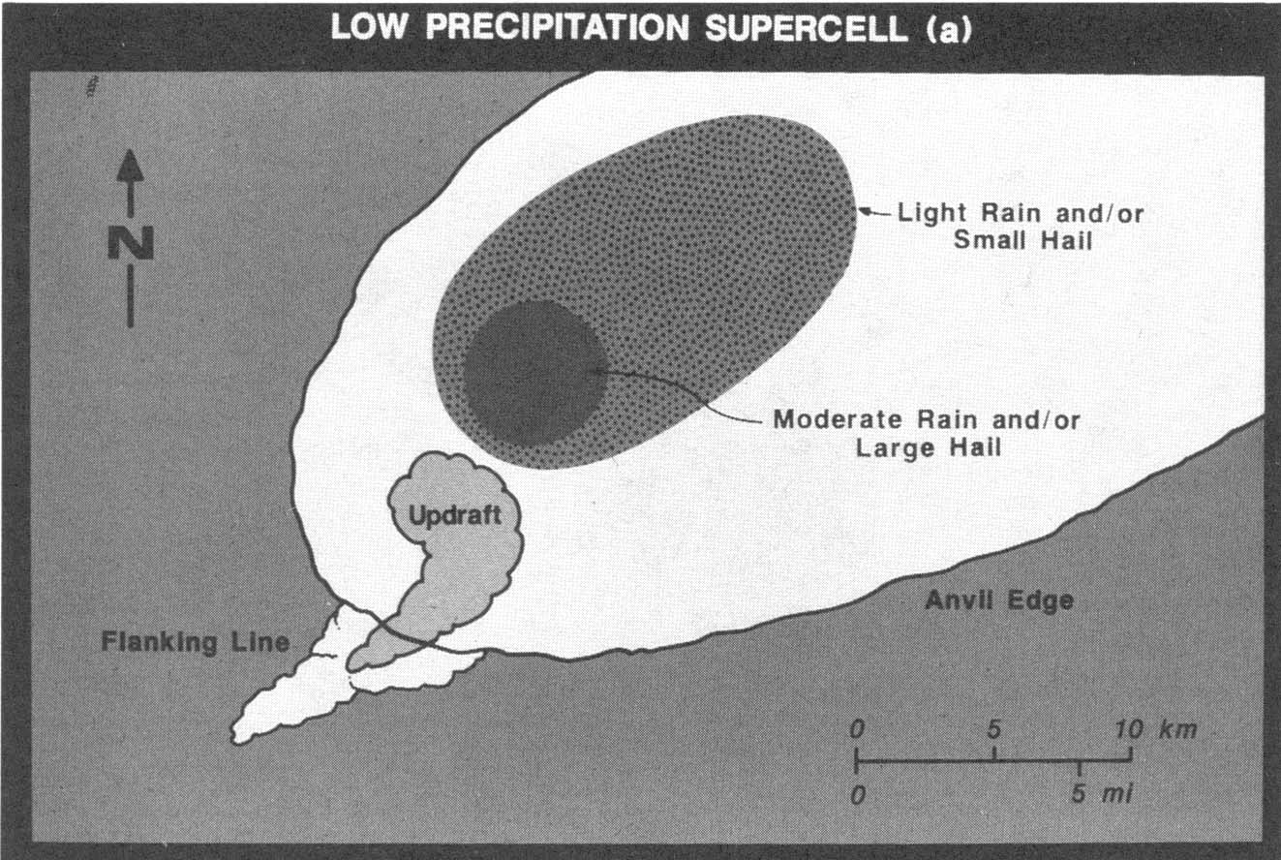
LP Supercell
Top View Schematic
© 1993 American Geophysical Union -- From: Church et al., The Tornado

Slide 19
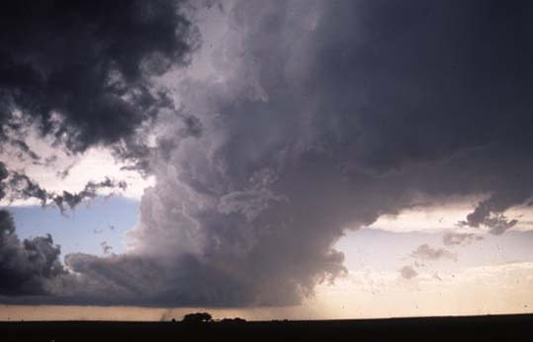
LP Supercell
© 1995 Robert Prentice

Slide 20
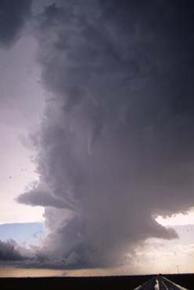
LP Supercell
© 1995 Robert Prentice

Slide 21
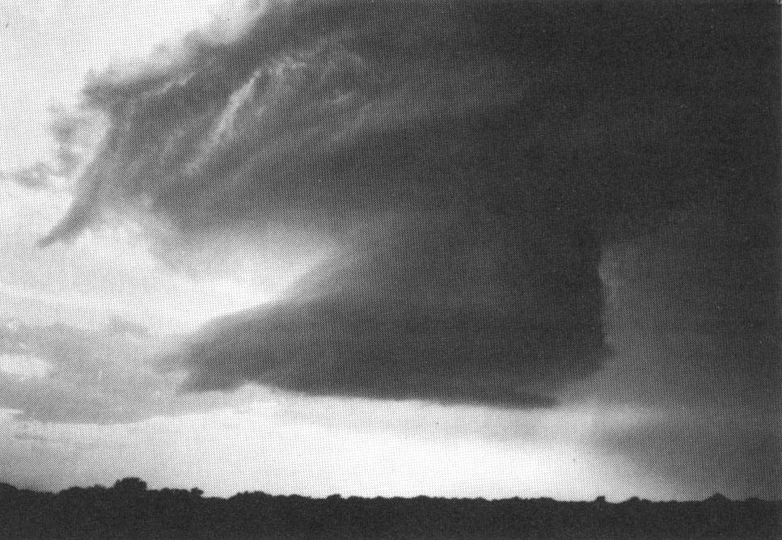
Another LP Supercell
© 1993 Oxford University Press -- From: Bluestein, Synoptic-Dynamic Meteorology -- Volume II: Observations and Theory of Weather Systems

Slide 22
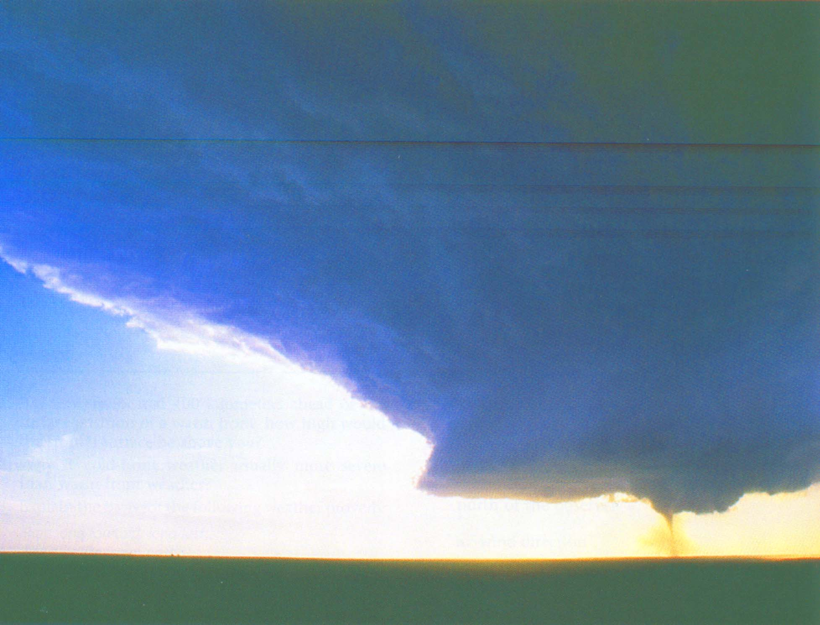
A Tornadic LP Supercell
26 May 1994 -- Texas Panhandle
© 1998 Prentice-Hall, Inc. -- From: Lutgens and Tarbuck, The Atmosphere, 7th Ed.

Slide 23
High Precipitation (HP) Supercells
Substantial precipitation in mesocyclone
May have a recognizable hook echo on radar (many do not, however)
Reflectivities in the hook are comparable to those in the core
Most common form of supercell
May produce torrential, flood-producing rain
Visible sign of rotation may be difficult to detect -- Easily detected by radar

Slide 24
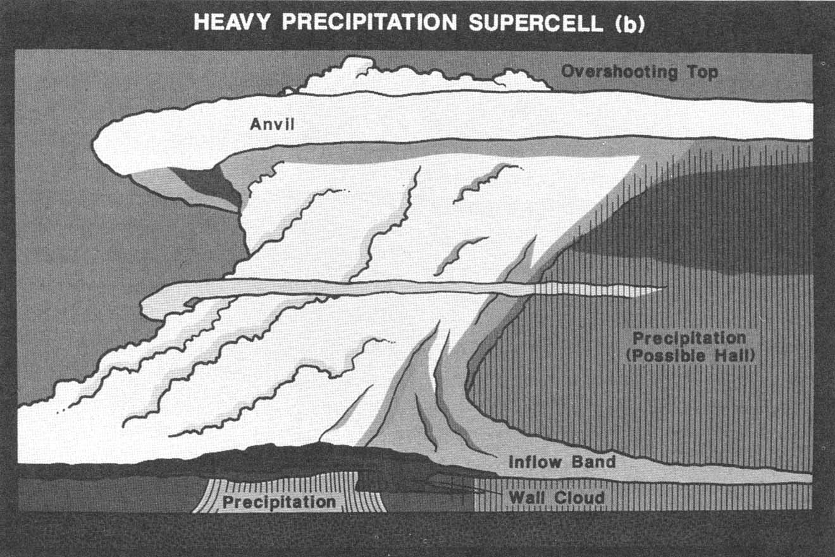
HP Supercells
© 1993 American Geophysical Union -- From: Church et al., The Tornado

Slide 25
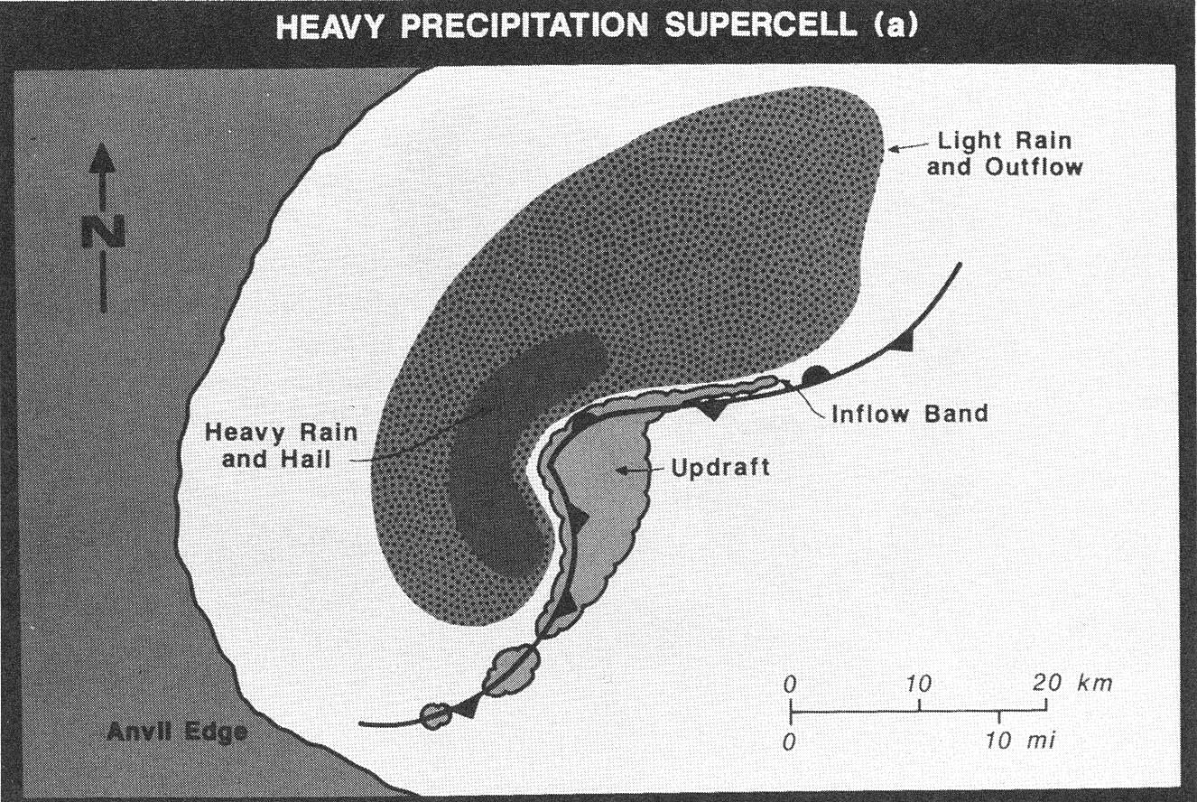
HP Supercells
© 1993 American Geophysical Union -- From: Church et al., The Tornado

Slide 26
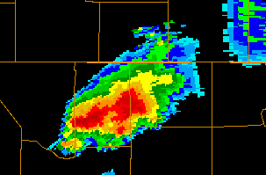
HP Supercell
Heaviest
Precipitation
(core)
Kansas
Woods County,
Oklahoma
Oklahoma
4 OCT 1998
2120 UTC
KTLX

Slide 27
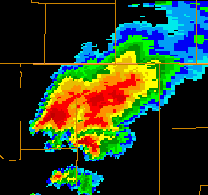
HP Supercell
Twenty
minutes
later …..
Heaviest
Precipitation
(core)
Kansas
Oklahoma
4 OCT 1998
2150 UTC
KTLX
Developing
Cells

Slide 28
Hybrids
Class distinctions are much less obvious in the real world!
Visibly a storm may look different on radar than it does in person -- makes storms difficult to classify
Supercells often evolve from LP ➔ Classic ➔ HP. There is a continuous spectrum of storm types.

Slide 29
Supercell Evolution
Early Phase
Initial cell development is essentially identical to that of a short-lived single cell storm.
Radar reflectivity is vertically stacked
Motion of the storm is generally in the direction of the mean wind
Storm shape is circular (from above) and symmetrical

Slide 30
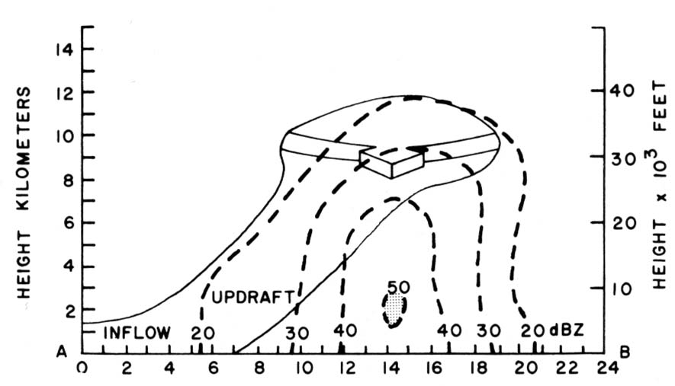
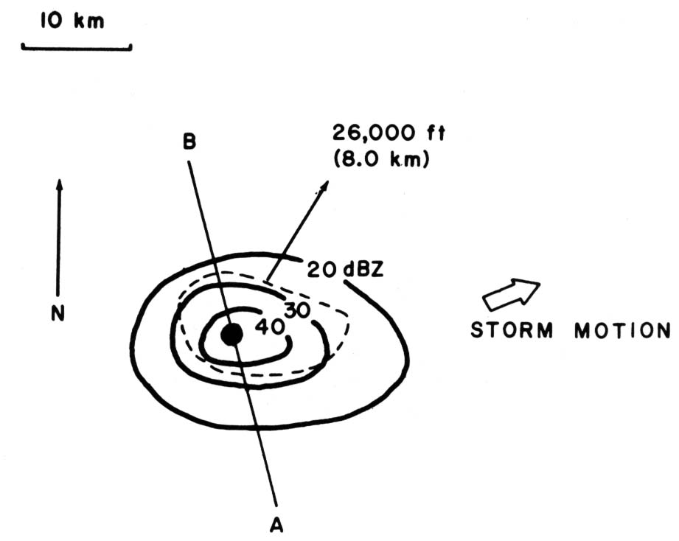
Supercell Evolution -- Early Phase
Side View
Top View
Heaviest
Precipitation
© 1993 Oxford University Press -- From: Bluestein, Synoptic-Dynamic Meteorology -- Volume II: Observations and Theory of Weather Systems

Slide 31
Supercell Evolution
Middle Phase
As the storm develops, the strong wind shear alters the storm characteristics from that of a single cell
The reflectivity pattern is elongated down wind -- the stronger winds aloft blow the precipitation
The strongest reflectivity gradient is usually along the SW corner of the storm
Instead of being vertical, the updraft and downdraft become separated

Slide 32
Supercell Evolution
Middle Phase
After about an hour, the radar pattern indicates a “weak echo region” (WER)
This tells us that the updraft is strong and scours out precipitation from the updraft
Precipitation aloft “overhangs” a rain free region at the bottom of the storm.
The storm starts to turn to the right of the mean wind into the supply of warm, moist air

Slide 33
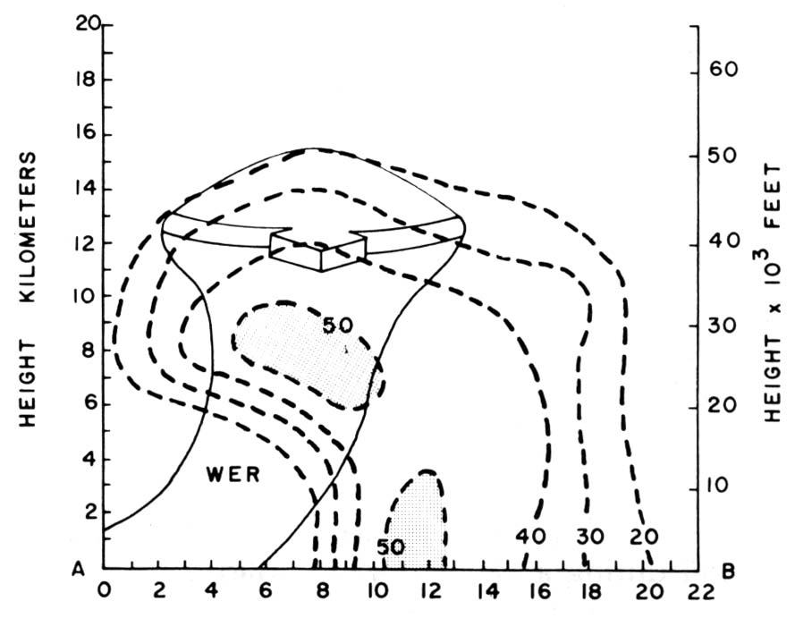
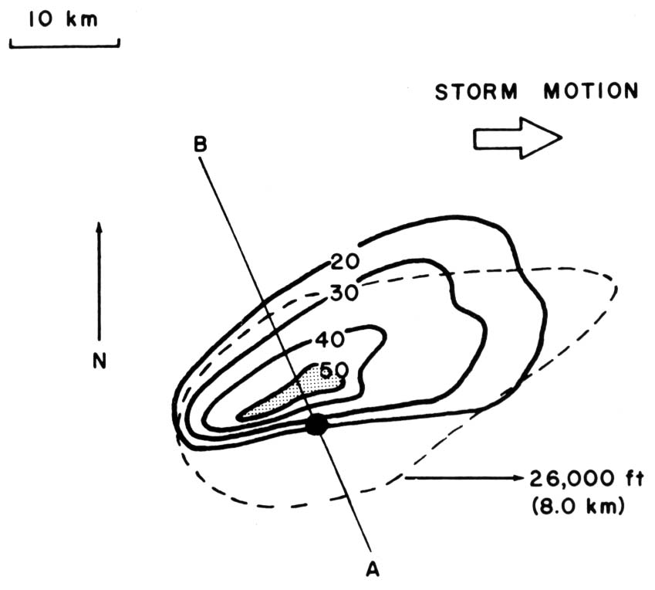
Supercell Evolution -- Middle Phase
Side View
Top View
Heaviest
Precipitation
© 1993 Oxford University Press -- From: Bluestein, Synoptic-Dynamic Meteorology -- Volume II: Observations and Theory of Weather Systems

Slide 34
Supercell Evolution
Mature Phase
After about 90 minutes, the storm has reached a quasi-steady mature phase
Rotation is now evident and a mesocyclone (the rotating updraft) has started
This rotation (usually CCW) creates a hook-like appendage on the southwest flank of the storm

Slide 35
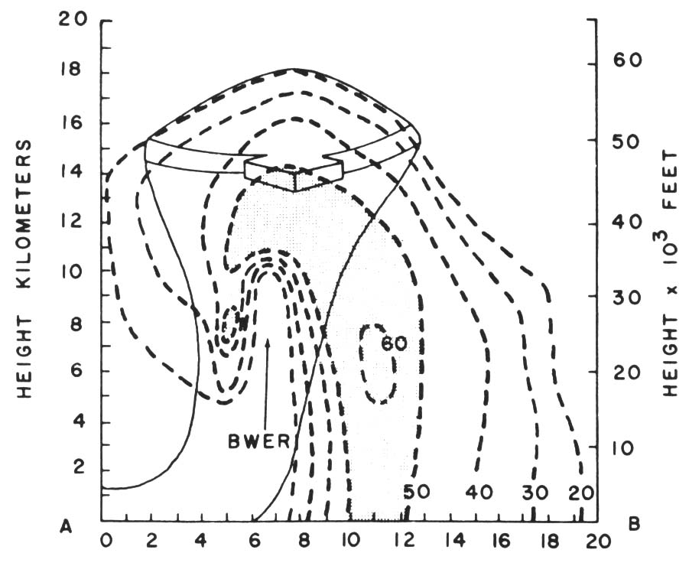
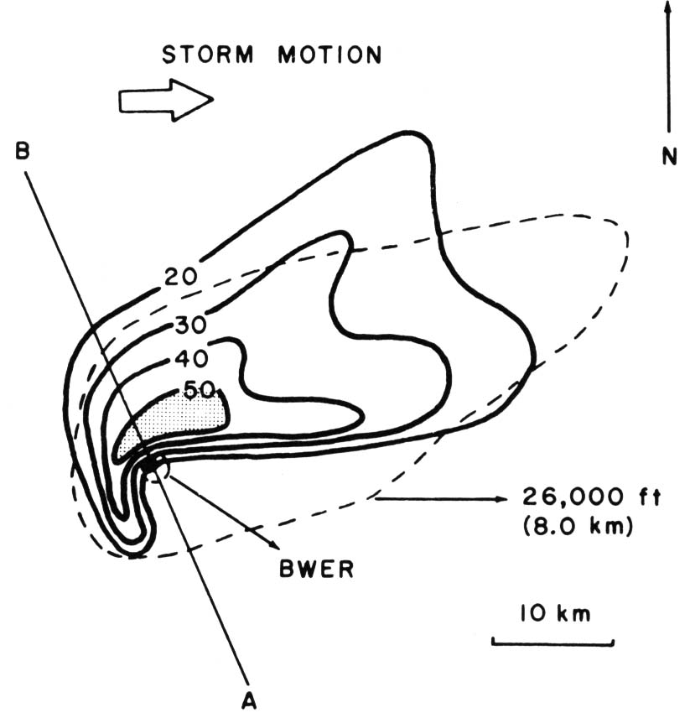
Supercell Evolution -- Mature Phase
Side View
Top View
Hook
Heaviest
Precipitation
© 1993 Oxford University Press -- From: Bluestein, Synoptic-Dynamic Meteorology -- Volume II: Observations and Theory of Weather Systems

Slide 36
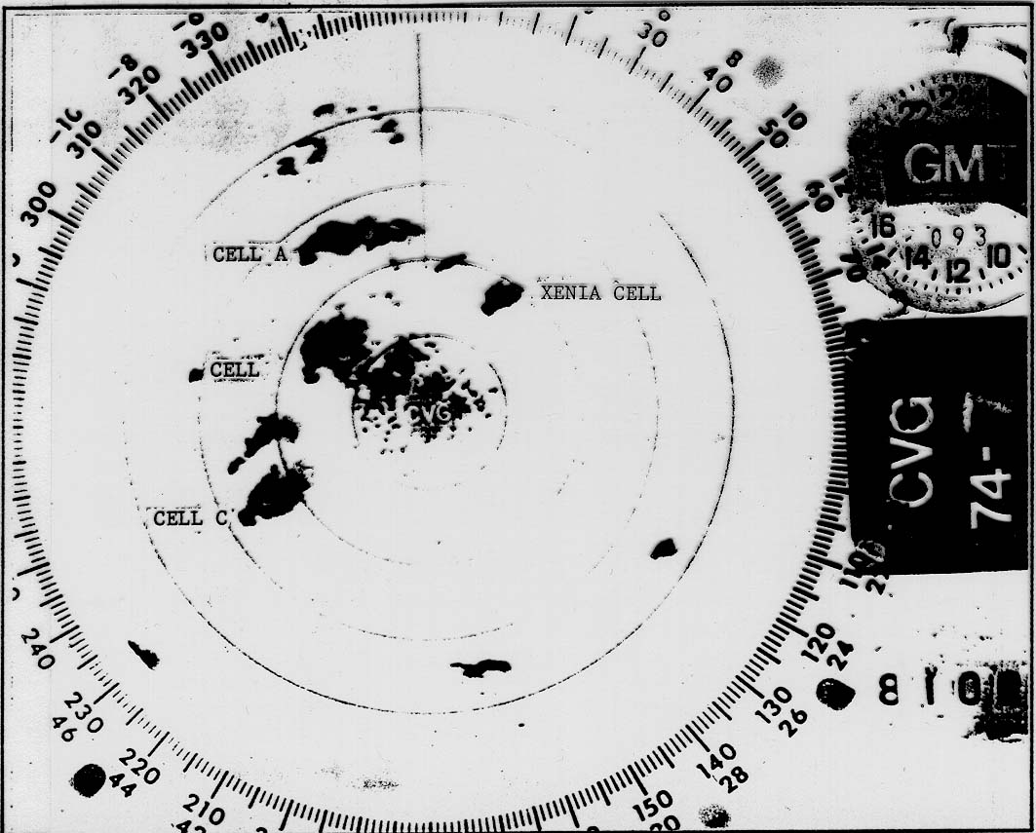
Supercell Evolution -- Mature Phase
Hook
Echo

Slide 37
Supercell Evolution
Mature Phase
The updraft increases in strength and more precipitation, including hail, is held aloft and scoured out of the updraft
As the storm produces more precipitation, the weak echo region, at some midlevels, becomes “bounded”
This bounded weak echo region (BWER), or “vault,” resembles (on radar) a hole of no precipitation surrounded by a ring of precipitation

Slide 38
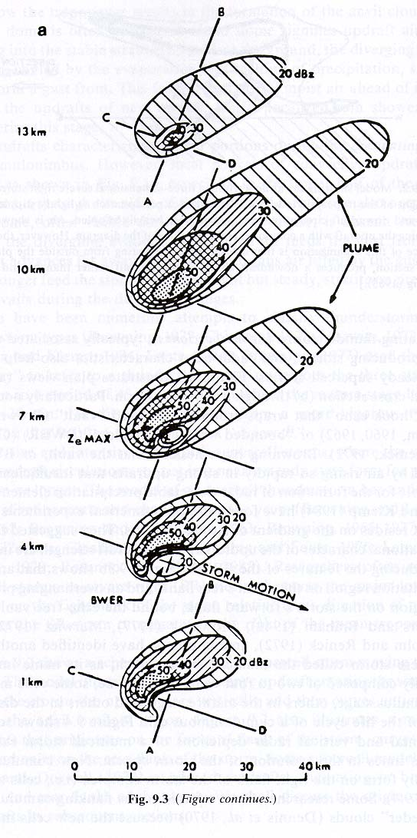
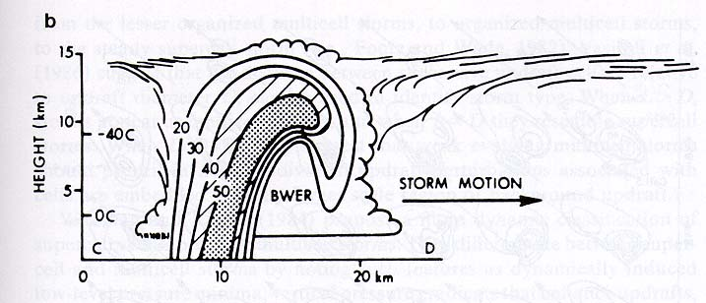
Supercell Evolution -- Mature Phase
Slice
4 km
Bounded Weak Echo Region
© 1990 *Aster Press -- From: Cotton, Storms

Slide 39
Splitting Storms
If the shear is favorable (often a straight line hodograph), the storm often tends to split into two new storms.
If the hodograph is curved CW, the southern storm is favored.
If the hodograph is curved CCW, the northern storm is favored.

Slide 40
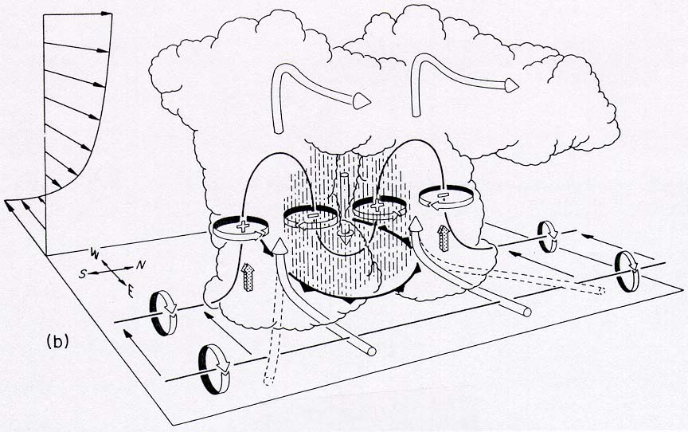
Splitting Storms
© 1990 *Aster Press -- From: Cotton, Storms

Slide 41
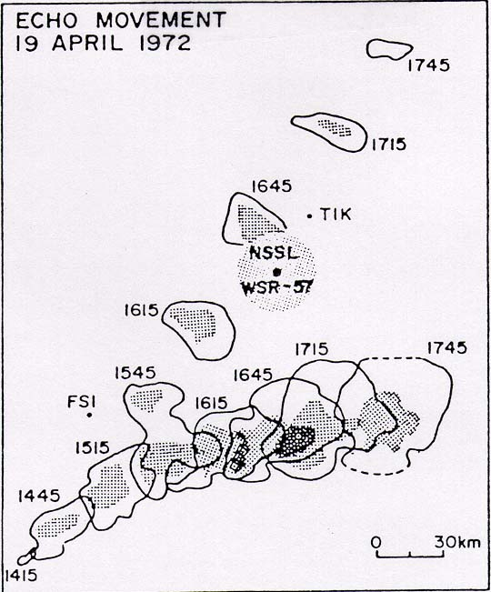
Splitting Storms
Left
Mover
Split
Right
Mover
© 1993 Oxford University Press -- From: Bluestein, Synoptic-Dynamic Meteorology -- Volume II: Observations and Theory of Weather Systems

Slide 42
Updraft
The updraft is the rising column of air in the supercell
They are generally located on the front or right side of the storm
Entrainment is small in the core of the updraft
Updraft speeds may reach 50 m s⁻¹!!!
Radar indicates that the strongest updrafts occur in the middle and upper parts of the storm

Slide 43
Updraft
Factors affecting the updraft speed
Buoyancy
The more unstable the air, the larger the buoyancy of the parcel as they rise in the atmosphere
The larger the temperature difference between the parcel and the environment, the greater the buoyancy and the faster the updraft
Vertical pressure gradients
Small effect but locally important
Regions of local convergence can result in local areas of increased pressure gradients
Updraft rotation creates upwards VPGF at lower levels
Turbulence
Turbulence reduces updraft intensity

Slide 44
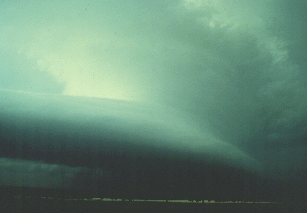
Rotating Updrafts - Visual Clue
The circular mid-level cloud bands and the smooth, cylindrical Cb strongly hint of updraft rotation. Above the mid-level cloud band, an extremely hard Cb top is barely visible (upper right) towering into the anvil.
Note the smooth, "laminar" flanking line on the extreme left. A strong, "capping" temperature inversion in the low levels probably accounted for the laminar appearance of the flank.

Slide 45
Structure of a Supercell Storm
Meso-
Cyclone

Slide 46
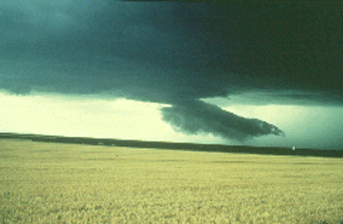
Wall Clouds - a lowering cloud base
It is believed that wall clouds develop when some rain-cooled air is pulled upward, along with the more buoyant air.
The rain-cooled air is very humid, and upon being lifted it quickly saturates to form the lowered cloud base.
Thus, the wall cloud probably develop sometime after an intense storm begins to precipitate.

Slide 48
The Wall Cloud
Meso-
Cyclone

Slide 49
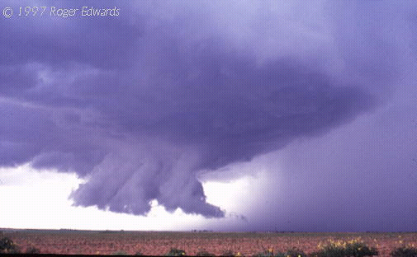
The Wall Cloud
Meso-
Cyclone

Slide 50
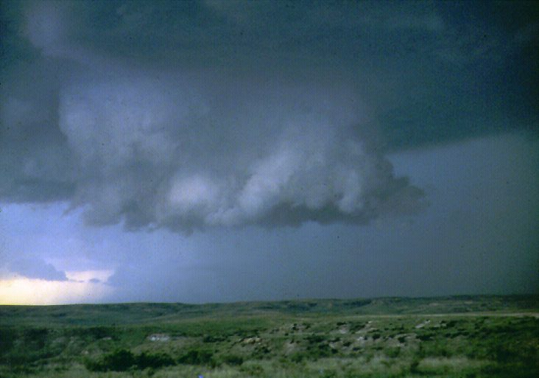
The Wall Cloud

Slide 51
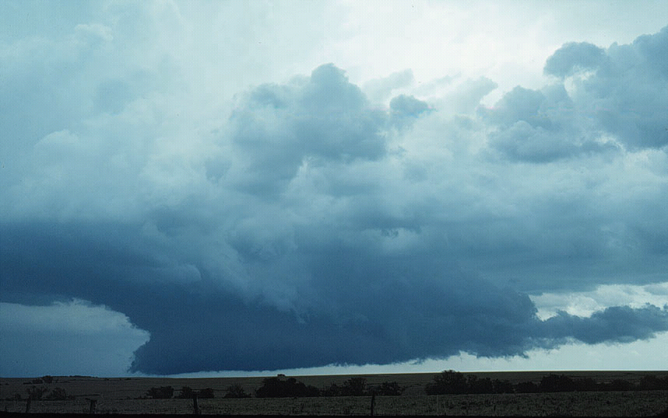
The Wall Cloud

Slide 52
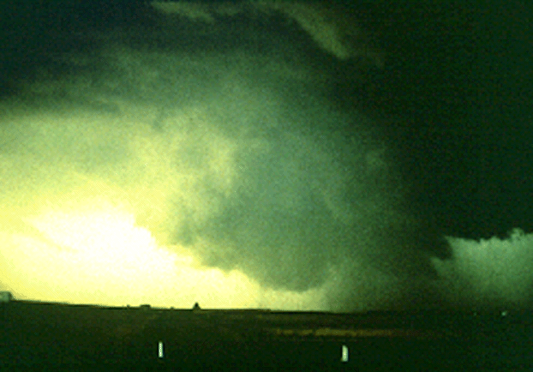
The Wall Cloud

Slide 53
Supercell Downdrafts
The same forces that affect updrafts also help to initiate, maintain, or dissipate downdrafts:
Vertical PGF
Buoyancy (including precipitation loading)
Turbulence
Downdraft wind speeds may exceed 40 m s⁻¹

Slide 54
Supercell Downdrafts
We shall examine two distinct downdrafts associated with supercell thunderstorms:
Forward Flank Downdraft (FFD)
Rear Flank Downdraft (RFD)

Slide 55
Supercell Downdrafts
Forward Flank
Downdraft
Rear Flank
Downdraft
Inflow
© 1993 Oxford University Press -- From: Bluestein, Synoptic-Dynamic Meteorology -- Volume II: Observations and Theory of Weather Systems

Slide 56
Forward Flank Downdraft
Associated with the heavy precipitation core of supercells.
Air in the downdraft originates within the column of precipitation as well as below the cloud base where evaporational cooling is important.
Forms in the forward flank (with respect to storm motion) of the storm.
FFD air spreads out when it hits the ground and forms a gust front.

Slide 57
Rear Flank Downdraft
Forms at the rear, or upshear, side of the storm.
Result of the storm “blocking” the flow of ambient air.
Maintained and enhanced by the evaporation of anvil precipitation.
Enhanced by mid-level dry air entrainment and associated evaporational cooling.
Located adjacent to the updraft.

Slide 58
Formation of the RFD
Imagine a river flowing straight in a smooth channel.
The water down the center flows smoothly at essentially a constant speed.
The pressure down the center of the channel is constant along the channel.

Slide 59
Formation of the RFD
Let us now place a large rock in the center of the channel.
The water must flow around the rock.
A region of high pressure forms at the front edge of the rock -- Here the water moves slowly -- Stagnation Point

Slide 60
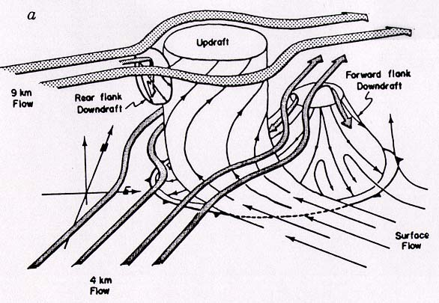
Formation of the RFD
This happens in the atmosphere also!
The updraft acts a an obstruction to the upper level flow.

Slide 61
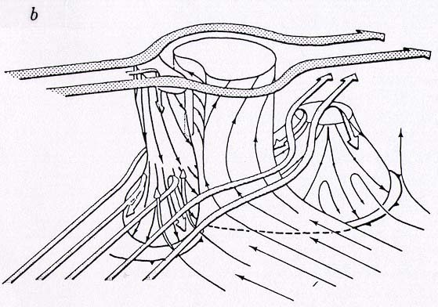
Formation of the RFD
The RFD descends, with the help of evaporatively cooled air, to the ground.
When it hits the ground, it forms a gust front.
Upper-level
Flow
Updraft
FFD
RFD
Mid-level
Flow
Gust
Front
Inflow

Slide 62
Bernoulli’s Equation
Where velocity us low, pressure is high

Slide 63
Supercell Storm Dynamics
Environmental Conditions and Storm Types
Early Development of Rotation
Storm Splitting
Helicity
Tornadic Phase of Supercell Storms

Slide 64
Effect of Environment on Storm Types
CAPE and Vertical Environmental Wind Shear are the two most important environmental factors determining the storm types
Numerical models have been very effective tools to understand such effects
In general, single cell storms occur in environment with little vertical shear
Multicell storms occur in environment with moderate vertical shear
Supercell storms occur in environment with strong vertical shear

Slide 65
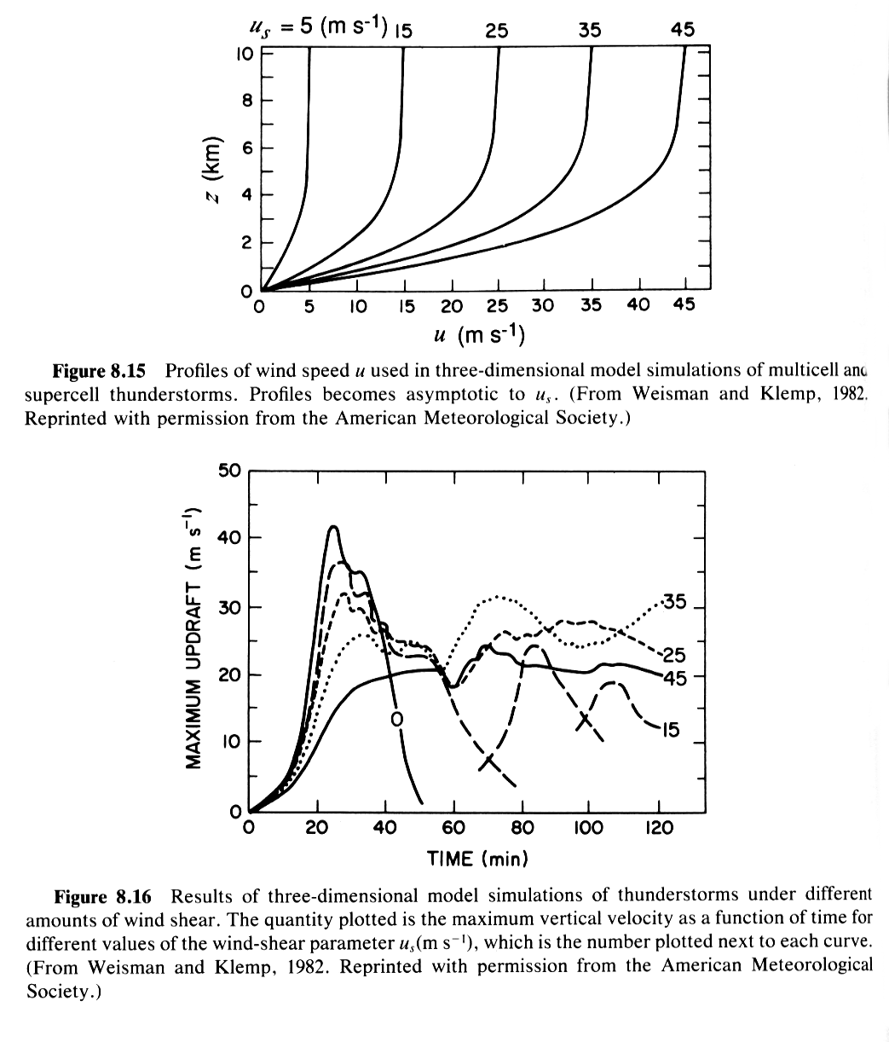
Numerical Experiments of Weisman and Klemp (1982)
Vertical wind profiles with unidirectional shear of different magnitudes
Time series of max w for 5 experiments
Supercell behavior is observed with u_{s} =25, 35 and 45m/s cases – quasi-steady updraft is found

Slide 66
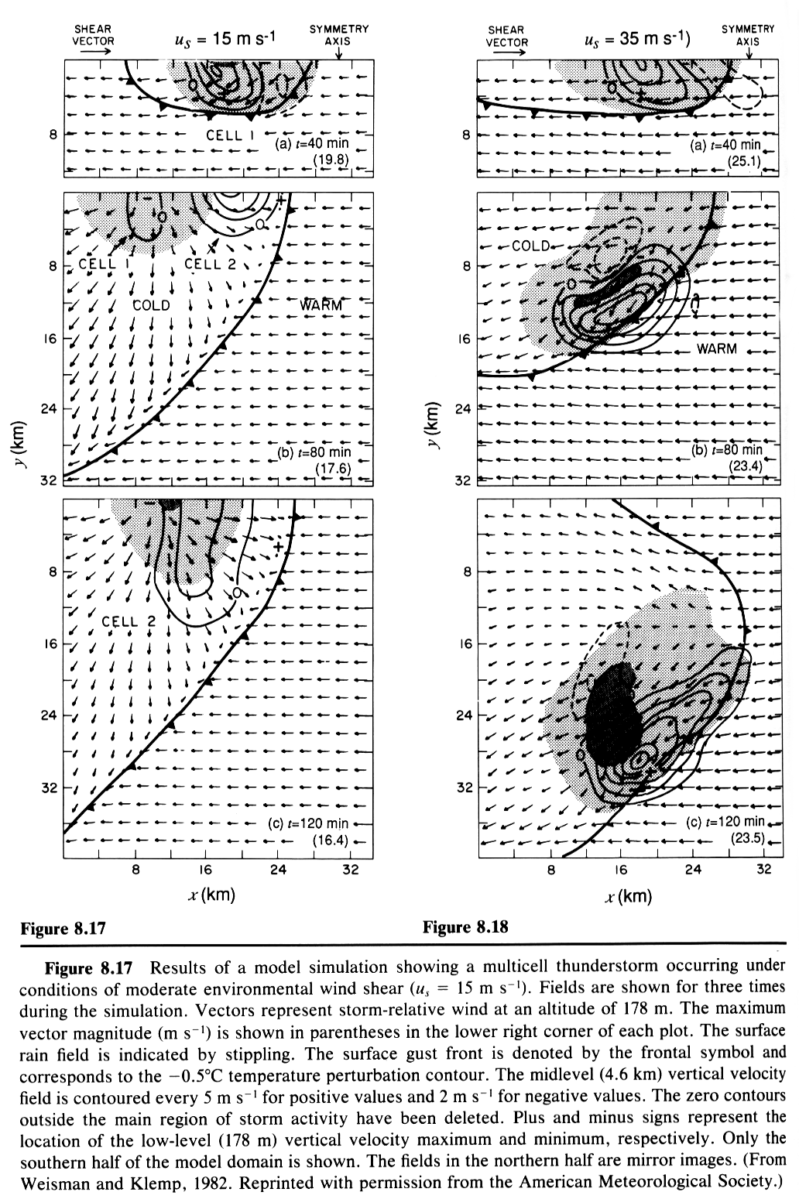
Results from u = 15m/s and 35 m/s cases
Multicell case (left) with u =15 m/s and supercell case (right) with u = 35m/s.
One the southern half of the computational domain is shown because the fields are symmetric about the central E-W axis
The splitting of the initial storm into two (only the southern member is shown).
The storm splitting is a result of rotational storm dynamics (more later). The member that moves to the right of vertical shear vector is called right mover, and the other the left mover.
When the shear is not unidirectional, i.e., when shear changes direction with height, one of the member will be favored, again due to rotational storm dynamics

Slide 67
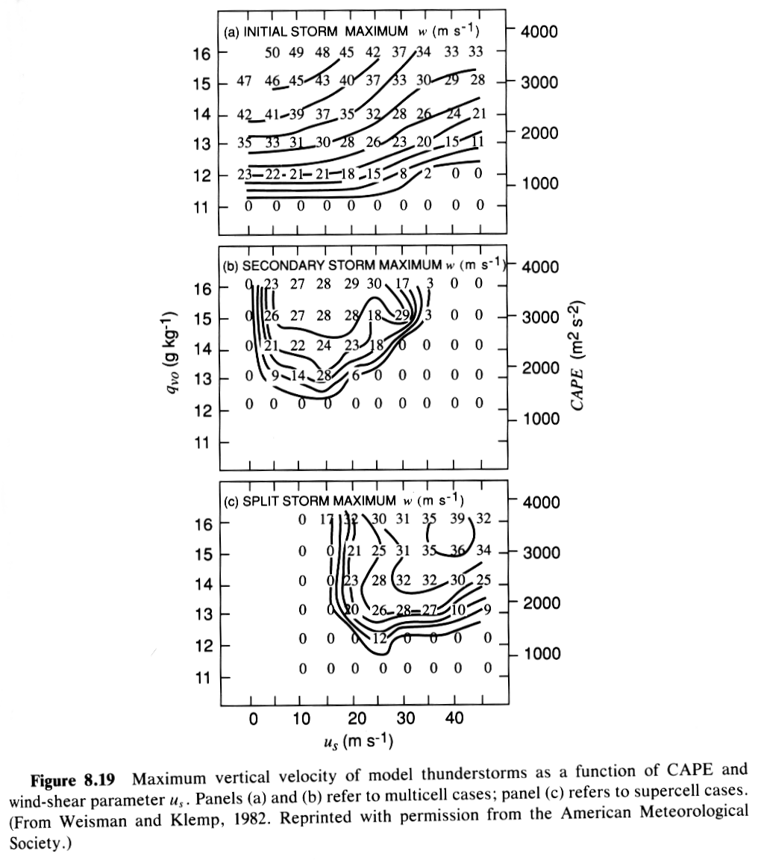
Maximum w as a function of CAPE and shear
The vertical axis is the low-level qv – higher value corresponds to higher CAPE
First cell intensity increases with CAPE and decreases with shear
Second cell occurs only with moderate shear.
Supercell storm occurs in stronger vertical shear.
Strong updraft can survive in supercells because of the support of pressure perturbations associated with vertical rotation which initially comes from horizontal vorticity in the environment via tilting.
Multicell case
Supercell case

Slide 68
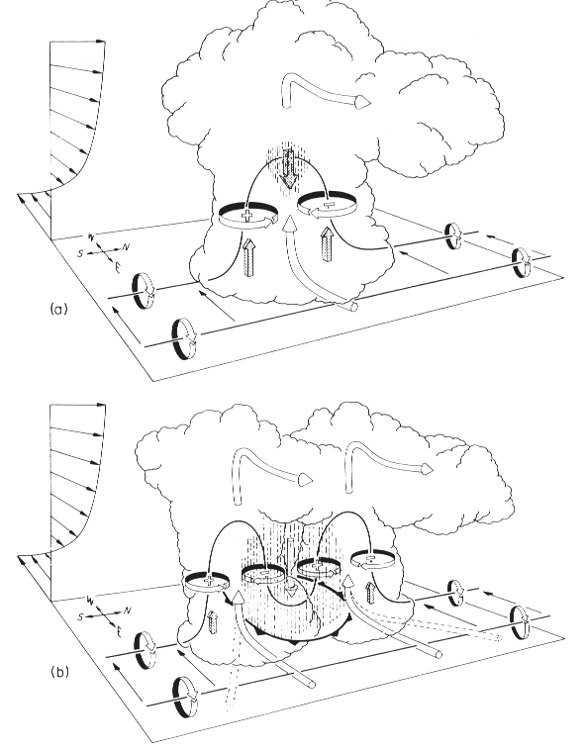
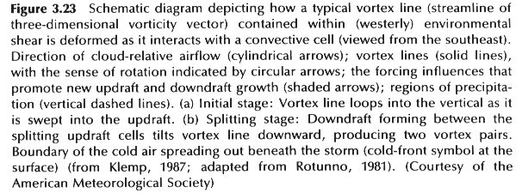
Generation of vertical vorticity via tilting

