Slide 1
Chapter 4 Convective Dynamics 4.5. Bright Bands, Bow Echoes and Mesoscale Convective Complexes
Photographs © Todd Lindley

Slide 2
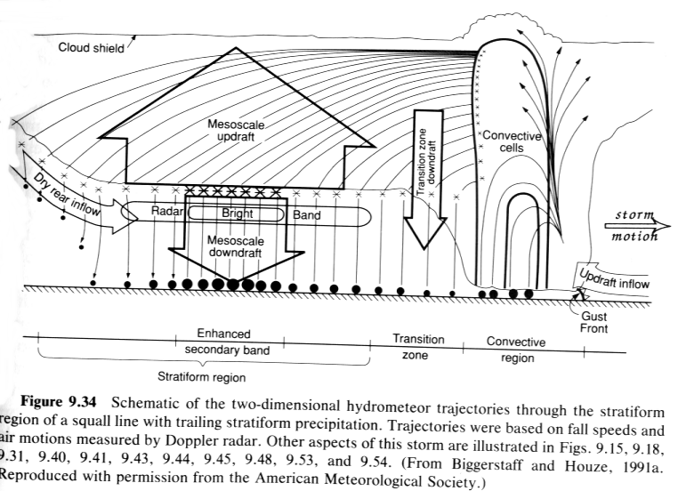
Bright band associated with stratiform precipitation in a squall line system

Slide 3
Bright band associated with stratiform precipitation
In stratiform precipitation regions, such as that in a mature squall line, a horizontal band of enhanced radar echo is often observed that is referred to as ‘bright band’.
The bright band is located at the level of zero degree C – i.e., the melting level
As the ice particles, snow flakes etc are half way through melting, their reflectivity is increased as they become enclosed by liquid water (water reflects radar beams more effectively than ice particles) while still keeping their size, resulting in a steep jump in radar echo
As they completely melt into rain drops, their sizes are reduced resulting reduced echo level, therefore we observed a layer of significantly enhanced reflectivity
Such observations of reflectivity can be used to study the microphysical properties of the clouds
Sections 6.1.1-6.1.3 of Houze have detailed explanations of the microphysical processed involved.

Slide 5
Example of bright band associated with stratiform precipitation

Slide 6
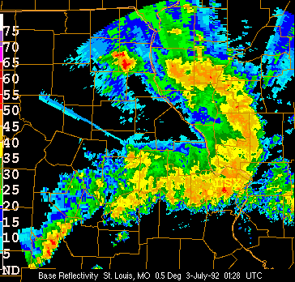
Bow Echoes
Bow echoes are relatively small (20-120 km long), bow-shaped systems of convective cells that are noted for producing long swaths of damaging surface winds.
They are observed both as relatively isolated convective systems and as sub-structures within much larger convective systems.
Bow echoes that develop within a squall line have been referred to as line echo wave patterns (LEWPs).

Slide 7
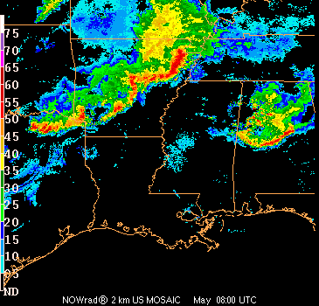
Bow Echoes/Line Echo Wave Pattern

Slide 8
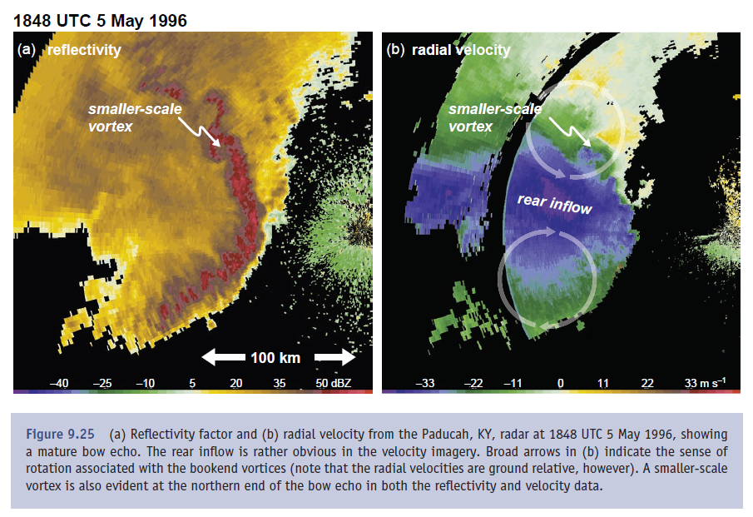
Reflectivity and Radial Velocity in a Strong Bow Echo

Slide 9
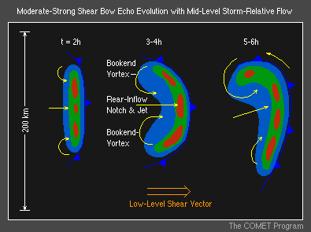
Bow Echo Conceptual Models
A bow echo has a well-recognized evolution starting as a strong isolated cell or a small line of cells that evolves into a symmetric bow-shaped segment of cells over a period of a couple hours, and eventually into a comma-shaped echo over several hours.
Cyclonic and anticyclonic line-end (or bookend) vortices are evident behind the northern and southern ends of the bow, respectively, in the early phases. This symmetric structure becomes more asymmetric during the comma echo phase when the cyclonic vortex begins to be dominant (Coriolis force is an factor favoring cyclonic vortex).
A weak echo notch behind the core of the bow, referred to as a "rear-inflow notch" (RIN), often signifies the location of a strong rear-inflow jet.
When the rear-inflow jet descends to the ground at the leading edge of the bow, it can create a swath of damaging surface winds. Weak tornadoes are also often observed just north of this surface jet core.

Slide 10
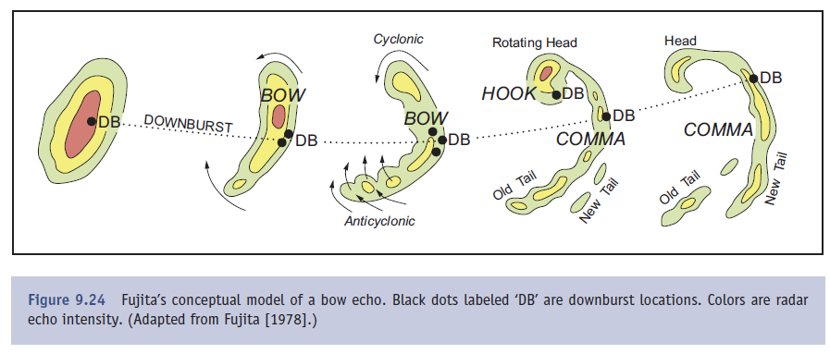
Fujita’s Conceptual Model

Slide 11
Bow Echo Conceptual Models
Bow echoes tend to propagate in the direction of the low-level (0-3 km AGL) mean vertical wind shear vector, at a speed controlled by the propagation speed of the cold pool. Since the cold pools in bow echoes are often exceptionally strong, their propagation speed is often much faster than nearby convective cells or systems.

Slide 12
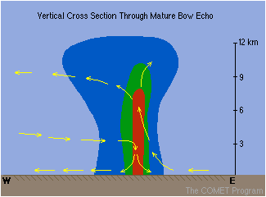
Bow Echo Vertical Cross Section
A vertical cross section through the core of the bow depicts a strong, vertically erect updraft at the leading edge of the system, with a strong, elevated rear-inflow jet impinging to just behind the updraft region at mid-levels before descending rapidly to spread along the surface.
Above the rear-inflow jet, the updraft current turns rapidly rearward, feeding into the stratiform precipitation region. The pressure field (not shown) is characterized by a strong mesohigh at the surface, associated with the cold pool, and a strong mesolow at mid-levels, just above the mesohigh.

Slide 13
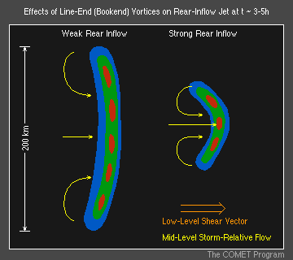
Bookend/Line-end Vortices in Bow Echoes
Bow echoes’ extreme intensity is due in large part to their relatively small size. In particular, the smaller distance between the bookend vortices enhances the focusing effect on the mid-level flow between the vortices, which can significantly strengthen the rear-inflow jet.
The descent of this enhanced rear-inflow jet to the surface tends to produce extreme surface winds
Water loading and downward dynamic pressure gradient forces (DPGF) are the possible causes of the descent, while recent studies have shown the latter being the primary cause.

Slide 14
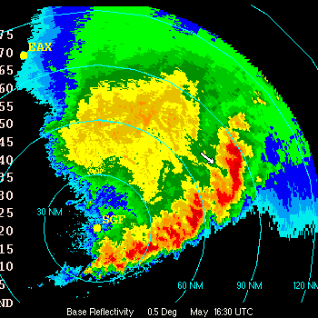
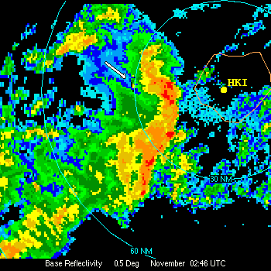
Rear Inflow Notch (RIN) Examples
A RIN apparent behind the bowing segment
A sharply defined RIN

Slide 15
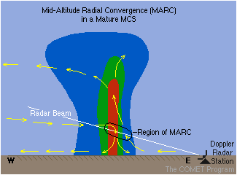
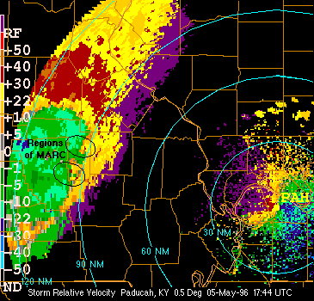
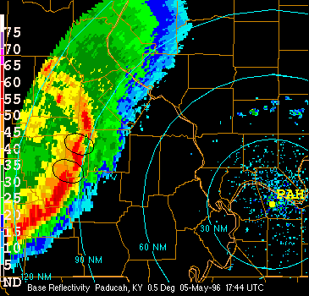
Mid-Altitude Radial Convergence (MARC)
MARC is a Doppler velocity signature that can serve as a precursor to the initial onset of damaging downburst winds in a squall line.

Slide 16
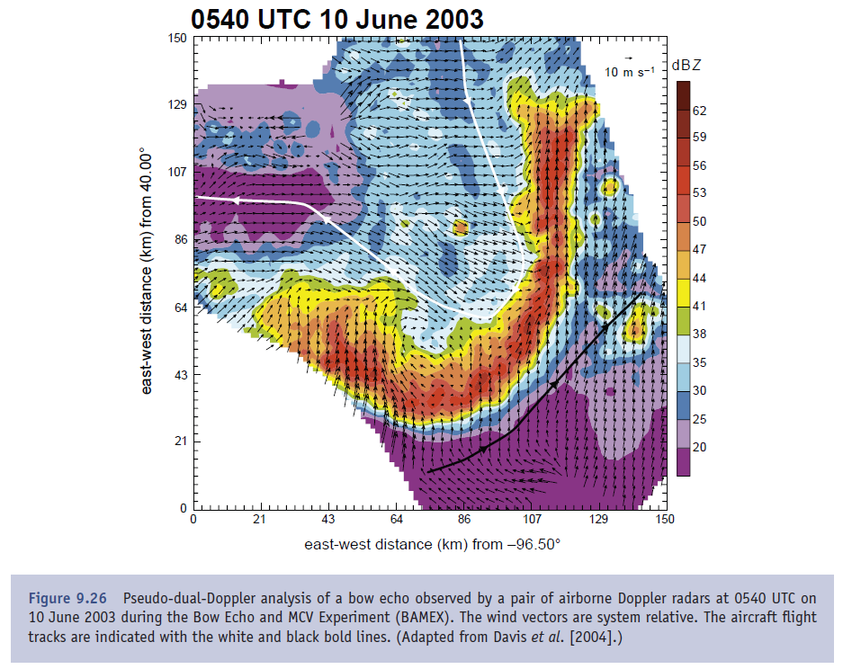

Slide 17
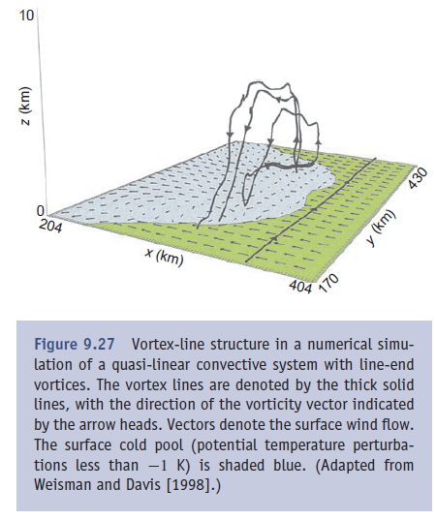
Bookend Vortices
When the line is of limited length, a bow echo may form, in which a couplet of vertical vorticity straddles the rear-inflow jet, with the most intense vorticity concentrated in bookend vortices.
In a mature bow echo, bookend vortices are the result of vortex lines being generated baroclinically in the cold pool of the squall line and subsequently being drawn upward by the leading updraft, which yields counter-rotating line-end vortices
The bookend vortices enhance the rear-inflow jet and initiate the bowing process.
After several hours, the accumulated effect of the Coriolis effect can cause the cyclonic vortex to become dominant, leading to a comma shape

Slide 18
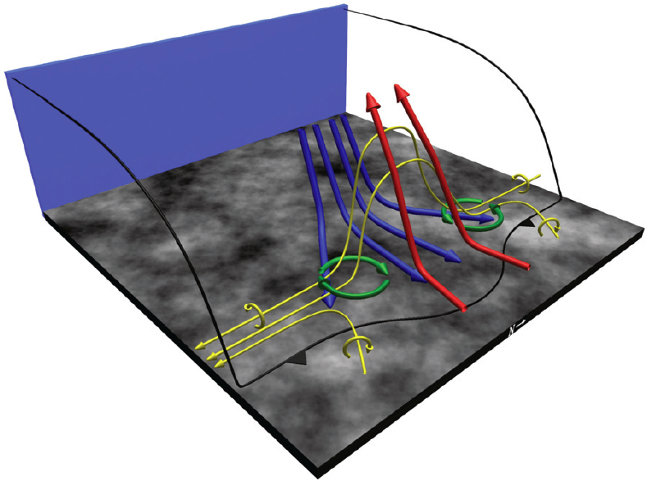
Uplift of baroclinically
generated horizontal
vorticity

Slide 19
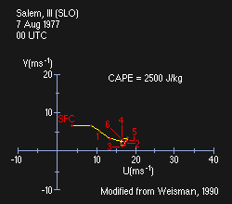
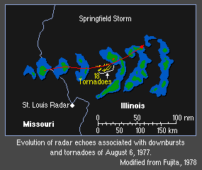
Severe Bow Echo Environments
Severe bow echoes are most often observed in environments with moderate-to-strong low-level shear and very high CAPE.
From a climatological study by Johns and Hirt (1987), the lifted index (LI) averages about -8 K (this usually indicates a CAPE value >2500), with an average 700-mb wind magnitude of 17 m/s.
This environment produced a strong bow echo.

Slide 20
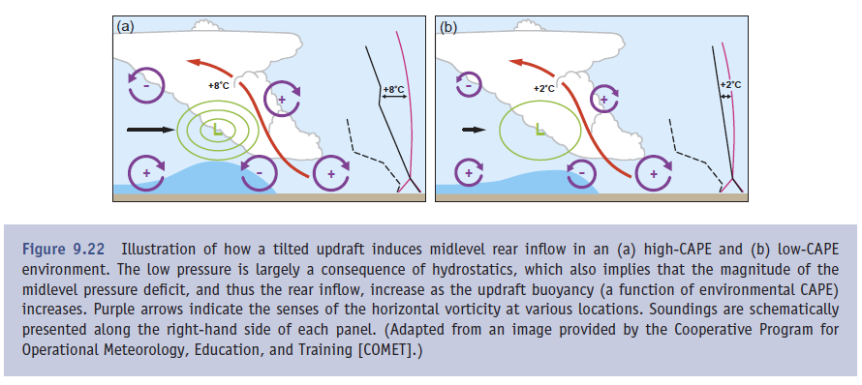
Promotion of rear inflow by horizontal gradient force
High CAPE Low CAPE

Slide 21
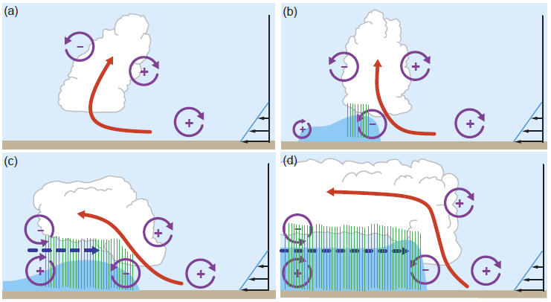
Vorticity Explanation of Rear Inflow Jet Formation
The updraft current is denoted by the thick double-lined flow vector, with the rear-inflow current in (c) and (d) denoted by the thick dashed vector. The shading denotes the surface cold pool. The thin, circular arrows depict the most significant sources of horizontal vorticity, which are either associated with the ambient shear or are generated within the convective system. Regions of lighter or heavier rainfall are indicated by the more sparsely or densely packed vertical lines, respectively. The scalloped line denotes the outline of the cloud (adapted in Weisman 1993 from Weisman 1992).

Slide 22
Four stages in the evolution of an idealized bow echo
(a) An initial updraft leans downshear in response to the ambient vertical wind shear, which is shown on the right in the figures
(b) The circulation generated by the storm-induced cold pool balances the ambient shear, and the system becomes upright.
(c) The cold pool circulation overwhelms the ambient shear, and the system tilts upshear, producing a rear-inflow jet.
(d) A new steady state is achieved whereby the circulation of the cold pool is balanced by both the ambient vertical wind shear and the elevated rear-inflow jet.

Slide 23
Typical Development and Evolution of Bow Echoes
Severe, long-lived bow echoes are produced in a restricted range of environmental conditions, including a convective available potential energy (CAPE) of at least 2000 m² s⁻² and vertical wind shears of at least 20 m s⁻¹ over the lowest 2.5-5 km AGL.
The key structural features include a 40-100-km-long bow-shaped segment of convective cells, with a strong rear-inflow jet extending to the leading edge of the bow at 2-3 km AGL, and cyclonic and anticyclonic eddies (referred to as "bookend" vortices) on the northern and southern flanks of the bowed segment, respectively.

Slide 24
Typical Development and Evolution of Bow Echoes
This bow echo structure characteristically develops three to four hours into the lifetime of a convective system and may remain coherent for several hours.
The evolution of this coherent structure occurs systematically as the convectively produced cold pool strengthens over time, eventually producing a circulation that overwhelms the ambient shear.
This forces the convective cells to advect rearward above the cold air and weaken. The horizontal buoyancy gradients along the back edge of these rearward-advecting cells subsequently generate an elevated rear-inflow jet that extends to near the leading edge of the cold pool.
The circulation of this jet helps negate the circulation of the cold pool, reestablishing deep, forced lifting at the leading edge of the system.
This elevated rear-inflow jet is also enhanced through the development of bookend vortices.
Such vortices are produced at the ends of a convective line segment as vortex lines created baroclinically (due to horizontal buoyancy gradient) at the edge of the downdraft are lifted upward by the convective updrafts, forming a vortex line arch and a vorticity couplet.
The development of these features requires both large amounts of CAPE and strong vertical wind shear in the environment of these systems.

Slide 25
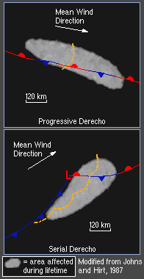
Progressive and Serial Derechos
A severe convective system may be composed of several bow echoes at the same time or a sequence of such features over time.
If the cumulative impact of the severe wind from these events covers a wide enough and long enough path, the wind event is generically referred to as a “derecho”.
Johns and Hirt (1987) have classified derechos as either progressive or serial.
Progressive Derechos are usually characterized by a single bow-shaped system that propagates north of, but parallel to, a weak east-west oriented stationary boundary.
Serial Derechos are composed of a series of bow-echo features along a squall line, usually located within the warm sector of a synoptic-scale cyclone.

Slide 26
Bow Echoes Summary
Bow echoes are typically 20-120 km long bow-shaped systems of convective cells that are noted for producing long swaths of damaging surface winds
Bow echoes may occur as either isolated convective systems or as part of much larger convective systems such as squall lines
The line-end vortices associated with bow echoes are often referred to as bookend vortices
A weak echo notch behind the core of the bow, referred to as a rear-inflow notch (RIN), often signifies the location of a strong rear-inflow jet
Bow echoes tend to propagate in the direction of the mean low-level vertical wind shear vector at a speed controlled by the cold pool propagation
A vertical cross section in the core of the bow echo reveals a strong, vertically erect updraft at the leading edge of the system; a strong, elevated rear-inflow jet impinging to just behind the updraft region before descending rapidly to the surface; and a system-scale updraft that turns rapidly rearward, feeding into the stratiform precipitation region

Slide 27
Bow Echoes Summary
Bow echoes often generate intense winds when the close proximity of the line-end vortices acts to strengthen the rear-inflow jet, leading to widespread, potentially damaging winds at the surface
If the cumulative impact of the severe wind from one or more bow echoes covers a wide enough and long enough path, the event is referred to as a derecho
Progressive derechos are characterized by a single bow-shaped system that propagates north of and parallel to a weak east-west oriented stationary boundary
Serial derechos are composed of a series of bow-echo features along a squall line, usually located within the warm sector of a synoptic-scale cyclone
Severe bow echoes are most often observed in environments with moderate-to-strong low-level shear and very high CAPE
Bow echo and supercell environments overlap, with bow echoes often characterizing the later stages of a supercell event

Slide 29
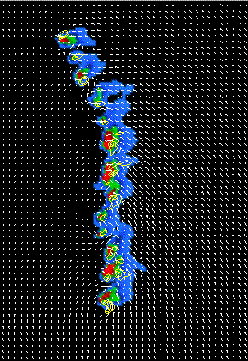
A numerical Simulation of a squall line with a series of embedded bow echoes

Slide 30
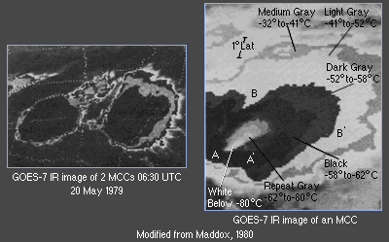
Mesoscale Convective Complex (MCC)

Slide 31
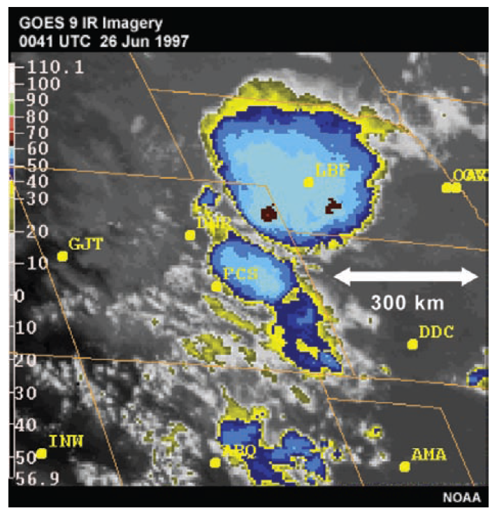
Infrared satellite image of a mesoscale convective complex (MCC) over Nebraska on 26 June 1997.
Note the fairly circular cirrus shield.

Slide 32
Mesoscale Convective Complex (MCC)
Mesoscale convective complexes (MCCs) represent a larger form of mesoscale convective system (MCS) organization.
A system is identified as an MCC based on its characteristics as depicted on IR satellite imagery.
The physical characteristics include a general cloud shield with continuously low IR temperatures less than -32° C over an area ≥ 100,000 km², with an interior cold cloud region with temperatures less than -52° C having an area ≥ 50,000 km².
MCCs often last for 6-12 h, and are especially known for producing heavy amounts of rain, although severe winds, hail, and tornadoes can also occur during the early phases of MCC evolution.

Slide 33
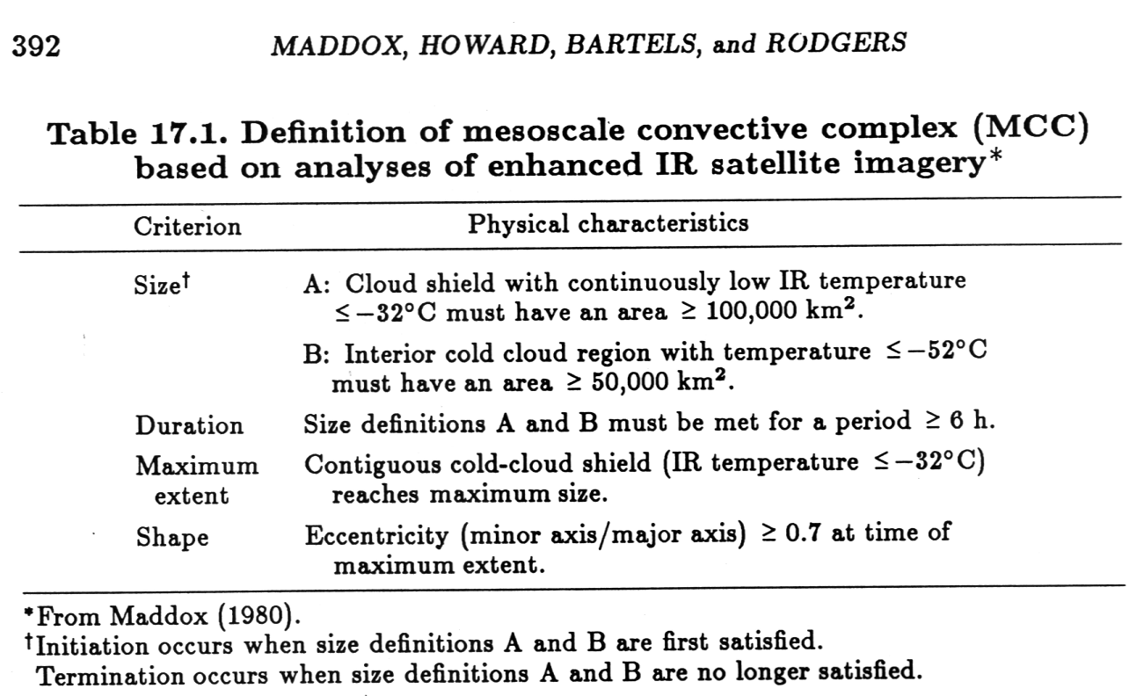

Slide 34
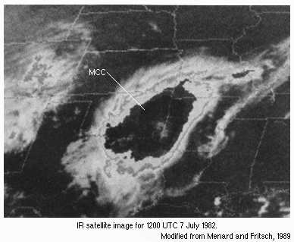
MCC Evolution
During the early phases of evolution, the convective structures that make up an MCC may include multiple squall lines, bow echoes, or isolated convective cells, each evolving through its own lifecycle, with each system contributing to the expanding MCC anvil as depicted on a satellite image.
During the later stages of evolution, however, a large stratiform precipitation region dominates the MCC, as it does in the later stages of squall line evolution.

Slide 35
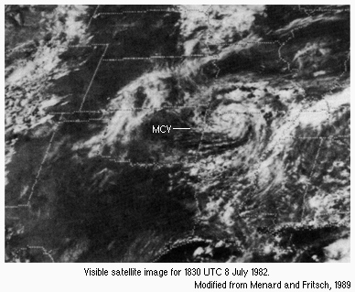
MCC Evolution
The flow field in the later stages of an MCC is characterized by divergent, anticyclonic outflow near the surface and aloft within the anvil, with convergent cyclonic flow at mid-levels.
Like the northern line-end vortices of squall lines that sometimes grow quite large, this mid-level cyclonic flow is often referred to as a mesoscale convective vortex (MCV).
MCCs are most often observed at night, in areas in which the boundary layer is stable. The source of energy for such systems is often found in an elevated layer above the boundary layer, north of a surface front.
Observational studies suggest that MCC structure and evolution is more dependent on interactions with large-scale forcing features than the boundary-layer-based mesoscale convective systems (MCSs) such as squall lines and bow echoes. In another word, cold pool tends to play a smaller role in MCCs.

Slide 36
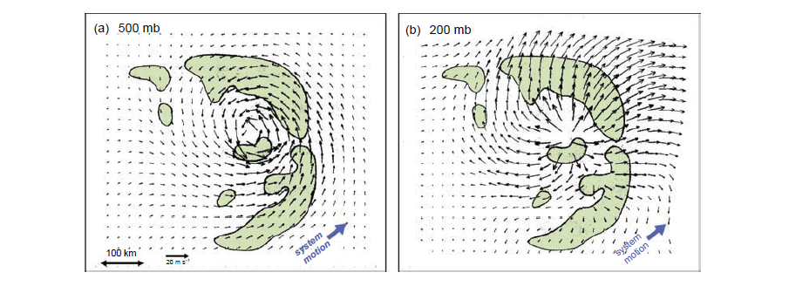
MCV at mid-level and anti-cyclone at upper level in MCC
Because of their size and duration, MCCs generate warm-core, meso-α-scale circulations that are organized on a much larger scale than the individual convective elements.
Near the tropopause (i.e., above the level of maximum convective heating), MCCs generate a mesohigh and divergent, anticyclonic outflow, once the accumulated effect of the Coriolis acceleration becomes significant.
Below the level of maximum convective heating, a low-pressure perturbation and convergent, cyclonic eddy is produced, called a mesoscale convective vortex (MCV).
200mb
500mb
Winds are system relative

Slide 37
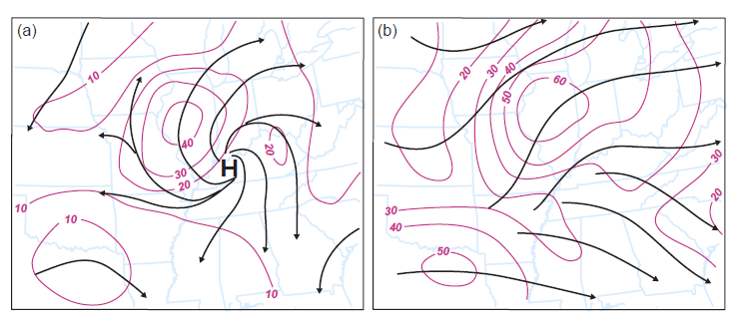
Upper level circulation associated with MCCs
The superpositioning of the upper-tropospheric anticyclone on the background synoptic wind field often leads to the formation of a mesoscale jet streak on the northwestern flank of the MCC.
200 mb
Without synoptic flow total flow

Slide 38
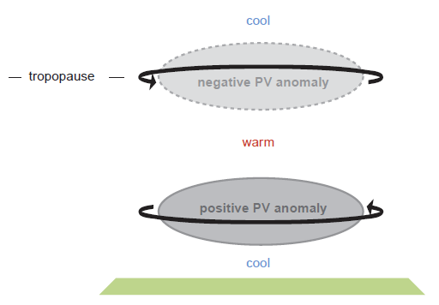
PV anomalies associated with sustained convective heating found in MCCs
The mesoscale potential vorticity (PV) anomalies and associated mesoscale circulations induced by the convective heating are an intrinsic characteristic of MCCs and play an important role in MCC maintenance.
In a statically stable atmosphere PV is reduced above and increased below the level of maximum convective heating.
A cyclonic circulation develops around the lower tropospheric positive PV anomaly, and an anticyclonic circulation develops around the upper tropospheric negative PV anomaly

Slide 39
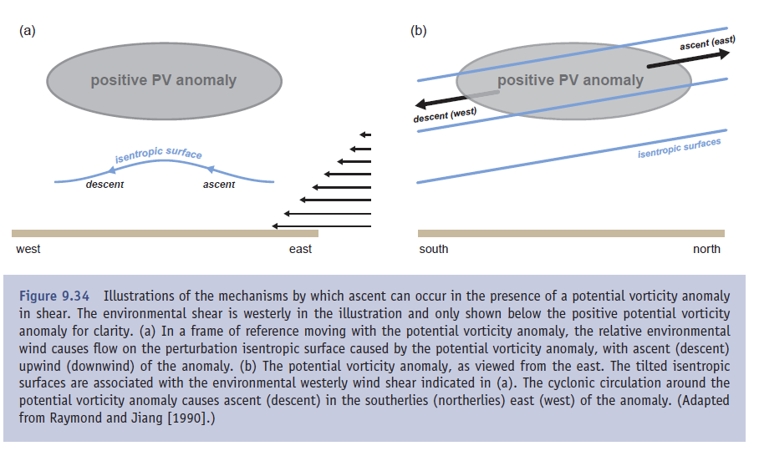
Ascent and descent associated with PV anomalies in a sheared environment
descent on west side
descent on west side
ascent on east side
ascent on east side

Slide 40
MCC Forcing and Maintenance
Adiabatic lifting along isentropic surfaces at the mid-to-lower levels plays an important role in MCC development and maintenance.
Lifting brings low-level parcels to LFC, and helps destabilize the layer by reducing CIN and increasing CAPE
MCCs are maintained as long as they have a supply of moist, conditionally unstable inflow (often aided by the presence of a low-level jet).
Lifting by gravity waves (bores, more precisely) can also be important in the maintenance of nocturnal MCSs in strongly stratified low-level environments
MCVs can persist much longer than the buoyant convection itself, occasionally even several days. MCVs some times initiate new convection on the subsequent days.

